Slide 1
The Influence of Demographics and Financial Factors on Car Purchase Price Among Indian Automobile Buyers
A Quantitative Analysis of Consumer Behavior
Name:

Slide 2
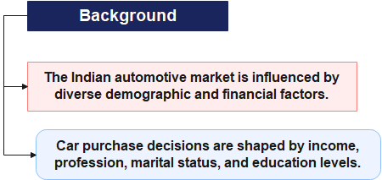
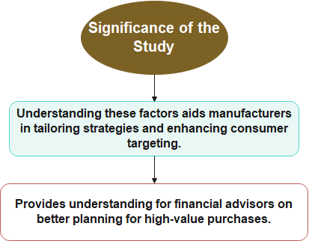

INTRODUCTION

Slide 3
Research Objectives
Primary Objectives
Examine whether profession influences car purchase prices.
Analyze the effect of marital status on car prices.
Predict car prices based on total salary and other demographic variables.
Objective | Key Variable
Influence of profession | Profession (salaried/business)
Impact of marital status | Marital status (married/single)
Predictive power of total salary | Total salary (continuous variable)

Slide 4
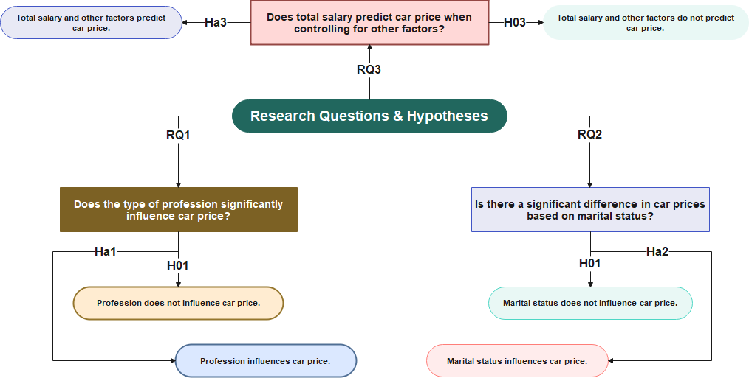
Research Questions & Hypotheses

Slide 5
Research Design
Variable | Type | Description | Coding
Age | Continuous | Buyer's age. | -
Profession | Categorical | Employment type. | Salaried (1), Business (0)
Marital Status | Categorical | Marital status. | Married (1), Single (0)
Education | Categorical | Education level. | Postgraduate (1), Graduate (0)
Number of Dependents | Continuous | Number of family dependents. | -
Personal Loan | Binary | Possession of a personal loan. | Yes (1), No (0)
House Loan | Binary | Possession of a house loan. | Yes (1), No (0)
Wife Working Status | Binary | Whether a spouse is employed. | Yes (1), No (0)
Salary | Continuous | Buyer's income. | -
Wife Salary | Continuous | Spouse's income. | -
Total Salary | Continuous | The combined income of the buyer and spouse. | -
Car Make | Categorical | Coded for statistical clarity. | -
Car Price | Continuous | Primary dependent variable (car price). | -
Dataset
Secondary data with 99 observations, including demographic and financial variables.
Key Variables:
Independent Variables: Profession, marital status, education, loan status.
Dependent Variable: Car price.
Data Preparation
Data cleaning ensured no missing values.
Coded variables for analysis: e.g., "1 = Married, 0 = Single."
Statistical Tools
Descriptive statistics, one-way ANOVA, independent t-tests, multiple regression.

Slide 6
Ethical Considerations
Ethical Guidelines
Anonymity of data (no personal identifiers).
No field data collection; used mentor-provided secondary data.
Transparency and integrity in data handling and reporting.
Considerations
No direct participant interaction.
Ethical concerns regarding informed consent were minimal.
Data Anonymity ✔
No Bias ✔
Accurate Reporting ✔
Integrity ✔

Slide 7
Descriptive Statistics
Key Continuous Variables
Age: Mean = 36 years; Range = 26–51 years.
Car Price: Mean = ₹1,194,040; Range = ₹110,000–₹3,000,000.
Total Salary: Mean = ₹2,270,707; Range = ₹200,000–₹5,200,000.
Key Categorical Variables
Profession: 64 salaried, 35 business.
Marital Status: 84 married, 15 single.
Education: 43 graduates, 56 postgraduates.

Slide 8
One-Way ANOVA
Research Question (RQ1)
Does the type of profession (salaried vs. business) significantly influence car price?
Method
Compared mean car prices between salaried and business professionals using ANOVA.
Results
F-value: 1.54; p-value: 0.219.
No significant difference between groups (p > 0.05).
Interpretation
Reject the alternative hypothesis.
Profession does not significantly influence car purchase price.

Slide 9
Independent Samples T-Test
Research Question (RQ2)
Is there a significant difference in car prices based on marital status (married vs. single)?
Method
Compared car prices using a two-sample t-test.
Results
t-statistic: 1.49; p-value: 0.139.
No significant difference between groups (p > 0.05).
Interpretation
Marital status does not significantly influence car purchase price.

Slide 10
Multiple Linear Regression – Overview
Research Question (RQ3)
Does total salary predict car price while controlling for other factors?
Method
Regression model with the dependent variable: car price.
Independent variables: total salary, profession, education, loan status.
Regression Model Summary
R-squared: 0.621 (62.1% of variability explained).
Significant predictor: Total Salary (p < 0.05).
Key Findings
Total salary is a significant predictor of car price.
Higher total salaries are associated with more expensive cars.
Other variables (profession, marital status, education) are not significant predictors.
Statistical Implications
Model confirms financial capacity (total salary) outweighs demographic attributes.
Total salary has a positive correlation (coefficient = 0.27).

Slide 11
Multiple Linear Regression – Results
SUMMARY OUTPUT
Regression Statistics
Multiple R | 0.788095
R Square | 0.621093
Adjusted R Square | 0.566672
Standard Error | 284321.7
Observations | 99
ANOVA
 | df | SS | MS | F | Significance F
Regression | 11 | 1.16608E+13 | 1.06007E+12 | 14.42471827 | 2.14839E-15
Residual | 88 | 7.11381E+12 | 80838801234
Total | 99 | 1.87746E+13
 | Coefficients | Standard Error | t Stat | P-value | Lower 95% | Upper 95% | Lower 95.0% | Upper 95.0%
Intercept | 721247 | 120274.2767 | 5.996685645 | 4.35406E-08 | 482227.1774 | 960266.8795 | 482227.2 | 960266.9
Wife Salary | 0.11478 | 0.154661494 | 0.742134899 | 0.45998187 | -0.192577528 | 0.422136913 | -0.19258 | 0.422137
Total Salary | 0.270907 | 0.060440063 | 4.48223928 | 2.21506E-05 | 0.1507949 | 0.391018749 | 0.150795 | 0.391019
Salary | 0 | 0 | 65535 | #NUM! | 0 | 0 | 0 | 0
No of Dependents | 34482.36 | 28709.11136 | 1.201094605 | #NUM! | -22570.96726 | 91535.68481 | -22571 | 91535.68
Salaried | 19090.87 | 64416.60399 | 0.296365657 | 0.767649156 | -108923.595 | 147105.3334 | -108924 | 147105.3
Married_ | -221349 | 120255.8173 | -1.840649849 | 0.069043076 | -460332.0188 | 17634.31496 | -460332 | 17634.31
post_grad | -36323.3 | 59425.20689 | -0.611244559 | 0.542613447 | -154418.4457 | 81771.77699 | -154418 | 81771.78
Personal_loan | -130546 | 77532.14485 | -1.683760898 | 0.095772148 | -284624.4395 | 23533.25186 | -284624 | 23533.25
House_loan | -142526 | 77881.68985 | -1.830029782 | 0.07063118 | -297299.3048 | 12247.681 | -297299 | 12247.68
Wife works | -36738.7 | 131046.5447 | -0.280348685 | 0.779868 | -297166.1965 | 223688.7436 | -297166 | 223688.7
Car_make | 6702.345 | 12656.68366 | 0.52954982 | 0.59775753 | -18450.1546 | 31854.84372 | -18450.2 | 31854.84

Slide 12
Discussion for RQ1 – Profession’s Influence on Car Price
Research Question
Does the type of profession (salaried vs. business) significantly influence car price?
Findings from One-Way ANOVA
F-value: 1.54; p-value: 0.219 (p > 0.05).
No significant difference in car prices based on profession.
Interpretation
Reject the alternative hypothesis (Hₐ1).
Consumer car prices are unaffected by whether they are salaried or in business.
Practical Implications
Marketing strategies need not prioritize profession segmentation.
Focus on shared lifestyle preferences rather than employment type.

Slide 13
Discussion for RQ2 – Marital Status and Car Price
Research Question
Is there a significant difference in car prices based on marital status (married vs. single)?
Findings from Independent Samples T-Test
t-statistic: 1.49; p-value: 0.139 (p > 0.05).
No significant difference between married and single buyers.
Interpretation
Reject the alternative hypothesis (Hₐ2).
Marital status does not significantly influence car prices.
Practical Implications
Car manufacturers should avoid marital-status-specific campaigns.
Strategies should focus on financial factors rather than demographic traits.

Slide 14
Discussion for RQ3 – Total Salary and Predicting Car Price
Research Question
Does total salary significantly predict car price while controlling for other factors?
Findings from Multiple Regression Analysis
R-squared: 0.621 (62.1% variability explained).
Significant Predictor: Total salary (p = 2.22E-05; coefficient = 0.27).
Insignificant Predictors: Profession, marital status, education, loan status.
Interpretation
Accept the alternative hypothesis (Hₐ3).
Total salary strongly predicts car price, with a positive correlation.
Practical Implications
Financial planning and income levels dominate car affordability considerations.

Slide 15
General Discussion
Key Findings
Demographic factors (profession, marital status) do not significantly influence car price.
Financial capacity (total salary) is the strongest predictor of car price.
Comparison with Literature
Consistent with Kumar (2021): Income drives car purchase behavior.
Contrasts Sharma et al. (2023): Demographic factors are less critical in the presence of strong financial indicators.
Implications for Stakeholders
Car manufacturers and financial advisors should focus on financial segmentation and income-based strategies.

Slide 16
Implications for Car Manufacturers
Product Design
Focus on functionality and lifestyle needs appealing to all income groups.
Marketing Strategies
Income-based advertising targeting high and middle-income groups.
Avoid profession- or marital-status-specific campaigns.
Financing Solutions
Partner with financial institutions for flexible car loans and EMI plans.

Slide 17
Implications for Financial Advisors
`
Income Planning
Encourage clients to align car purchases with sustainable budgets.
Highlight the importance of disposable income over demographic considerations.
Loan Management
Educate buyers on balancing personal loans, mortgages, and car financing.
Advisory Framework
Promote long-term financial health to support high-value investments.

Slide 18
Recommendations
For Manufacturers
Broaden product appeal across demographics.
Enhance partnerships with financial service providers.
For Financial Advisors:
Provide clear budgeting frameworks for car buyers.
Address misconceptions about demographic influence on car prices.
Future Research
Explore regional differences in car purchase behaviors.
Analyze the impact of brand loyalty and perception on car prices.

Slide 19
Conclusion
Summary of Findings
Demographic factors (profession, marital status) are less influential.
Total salary is the dominant factor in predicting car prices.
Significance
Highlights the need for income-centered approaches in marketing and financial advisory.
Final Remarks
This study contributes to understanding Indian consumer behavior in the automotive sector.

Slide 20
References
Bhatt, V. and Jigar Nagvadia (2021). -FACTORS INFLUENCING CONSUMER’S ONLINE BUYING BEHAVIOR: AN EMPIRICAL STUDY‖ Doctor of Philosophy in Management. [online] ResearchGate. Available at: https://www.researchgate.net/publication/355396679_-FACTORS_INFLUENCING_CONSUMER [Accessed 21 Nov. 2024].
Bryman, A. (2016). Social Research Methods. [online] Oxford University Press, pp.1–16. Available at: https://ktpu.kpi.ua/wp-content/uploads/2014/02/social-research-methods-alan-bryman.pdf [Accessed 21 Nov. 2024].
Field, A. (2018). Discovering Statistics Using IBM SPSS Statistics. [online] Available at: http://repo.darmajaya.ac.id/5678/1/Discovering%20Statistics%20Using%20IBM%20SPSS%20Statistics%20%28%20PDFDrive%20%29.pdf [Accessed 21 Nov. 2024].
Maheshwari, P., Seth, N. and Gupta, A.K. (2016). An Empirical Approach to Consumer Buying Behavior in Indian Automobile Sector. Industrial and Commercial Training, [online] 48(3), pp.156–162. doi:https://doi.org/10.1108/ict-09-2015-0061.
Saunders, M.N.K., Lewis, P. and Thornhill, A. (2019). Saunders, Research Methods for Business Students, 8/E. [online] Pearson. Available at: https://www.researchgate.net/publication/240218229_Research_Methods_for_Business_Students [Accessed 21 Nov. 2024].

Slide 21
Q&A
Thank you for your attention! Any questions or clarifications?”

